Slide 1



UNIT 8: Fit and healthy
Last weekend

Slide 2
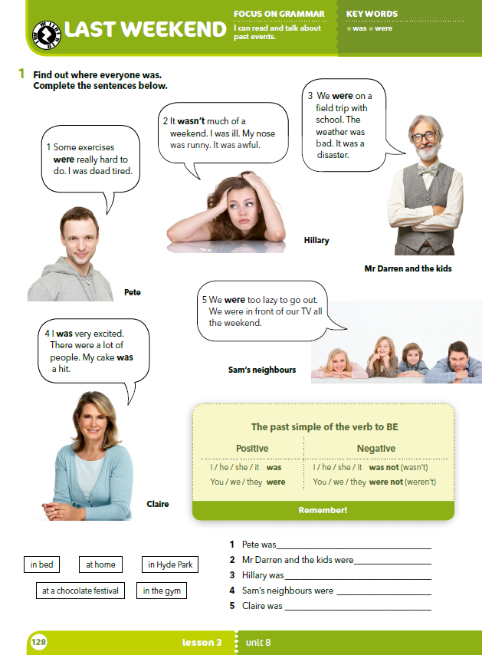
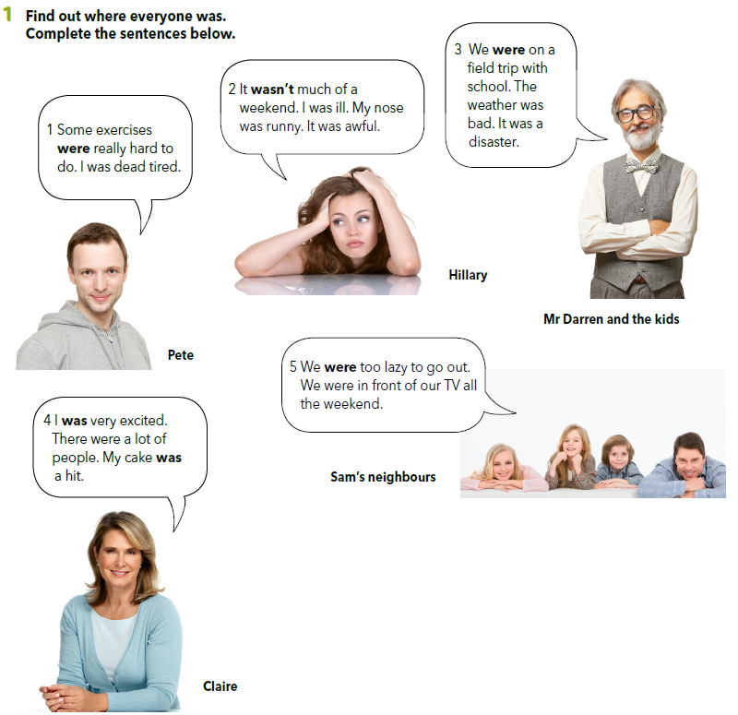
For each person think up his/her healthiest and his/her unhealthiest habit.

Slide 3
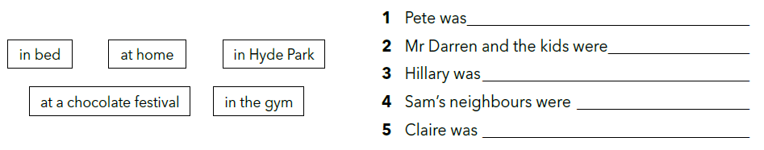
Read the texts and complete the sentences.
in the gym.
in Hyde Park.
in bed.
at home.
at a chocolate festival.

Slide 4
I was excited.
We were too lazy to go out.
What time are the people on this page talking about?
When did all of these things happen?
In the past.

Slide 5
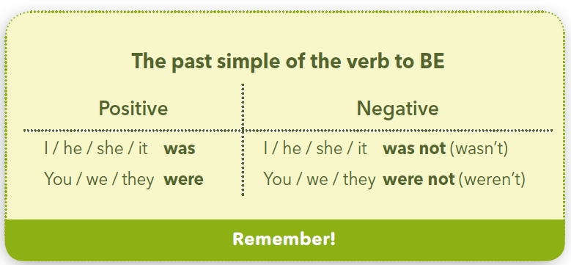

Slide 6
I was very excited. →
He was at home. →
She was happy. →
It was cold. →
You were at school. →
We were tired. →
They were at the cinema. →
Ja sam bio/la jako uzbuđen/a.
On je bio kod kuće.
Ona je bila sretna.
Bilo je hladno.
Ti si bio/la u školi. / Vi ste bili/le u školi.
Mi smo bili umorni.
Oni su bili u kinu. / One su bile u kinu.
I wasn’t angry. →
He wasn’t at work. →
We weren’t sad. →
Ja nisam bila ljuta.
On nije bio na poslu.
Mi nismo bili tužni.

Slide 7
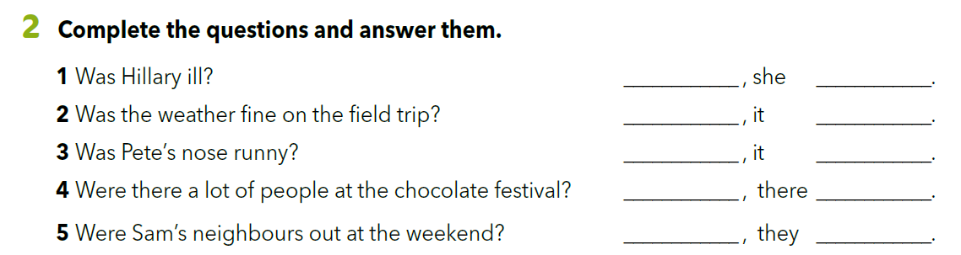
Yes was
No wasn’t
No wasn’t
Yes were
No weren’t
Turn the positive sentence into interrogative.
Tia was at home last weekend.
Tia was at home last weekend.
Was Tia at home last weekend?
Was Tia at home last weekend?

Slide 8
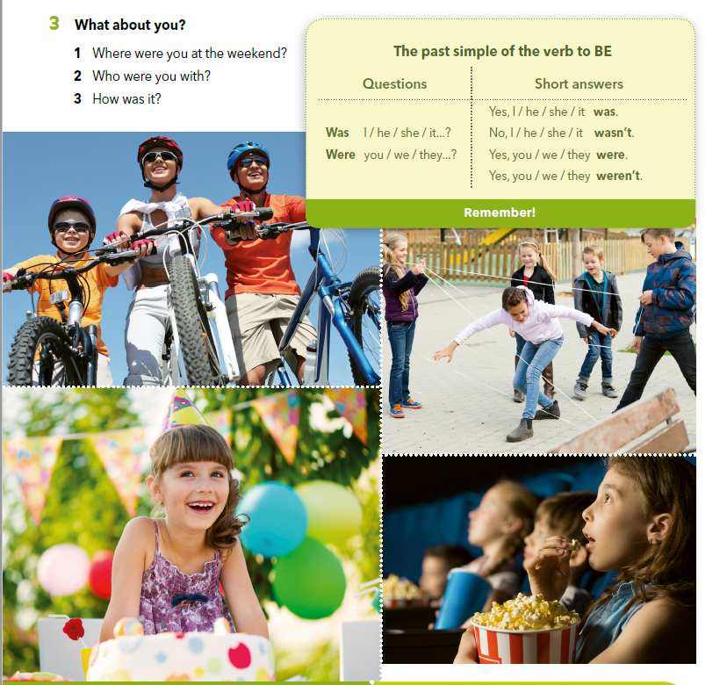
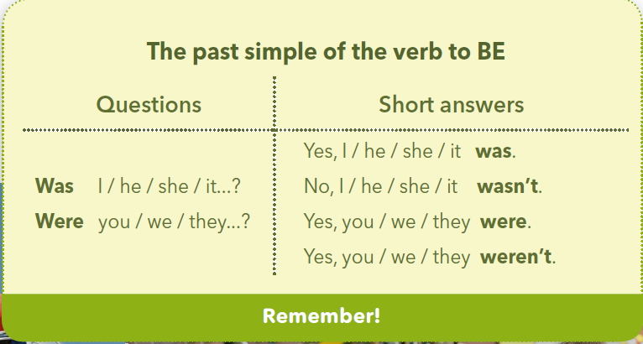
Imagine you were one of the people in the photos.
Answer the questions in task 3. Your friends have to guess which photo you are referring to.

Slide 9
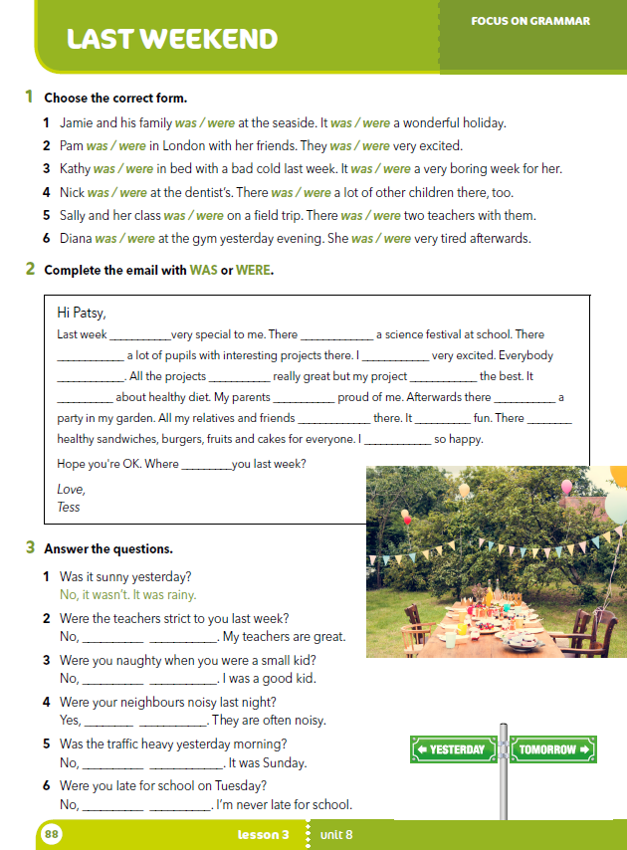
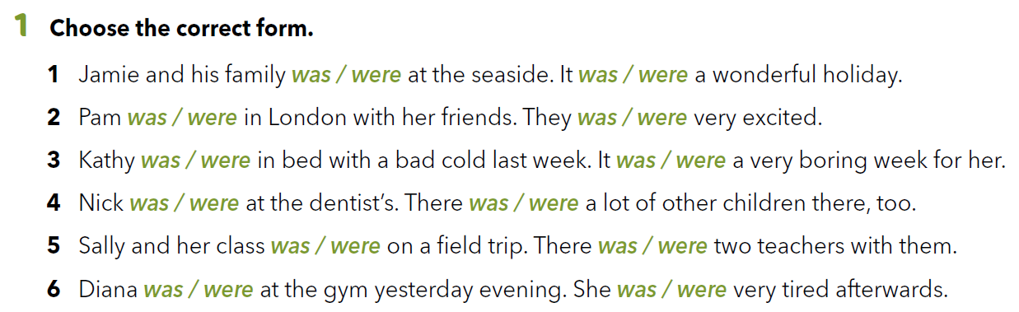
Workbook p. 88

Slide 10
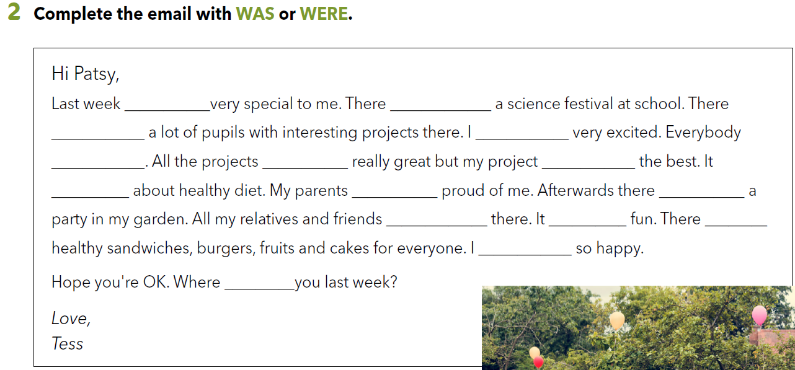
was
was
were
was
was
were
was
was
were
was
were
was
were
was
were

Slide 11
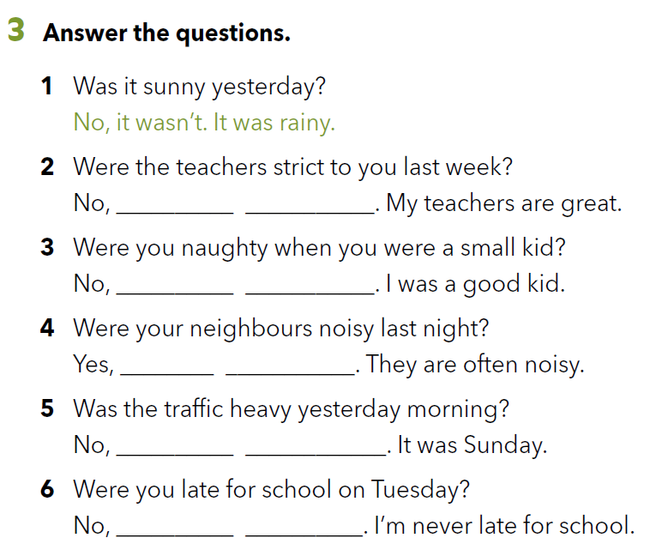
they weren’t
Razgovaraj sa svojim roditeljima / starateljima o svom ranom djetinjstvu. Pripremi nekoliko fotografija.
I wasn’t
they were
it wasn’t
I wasn’t

Slide 12
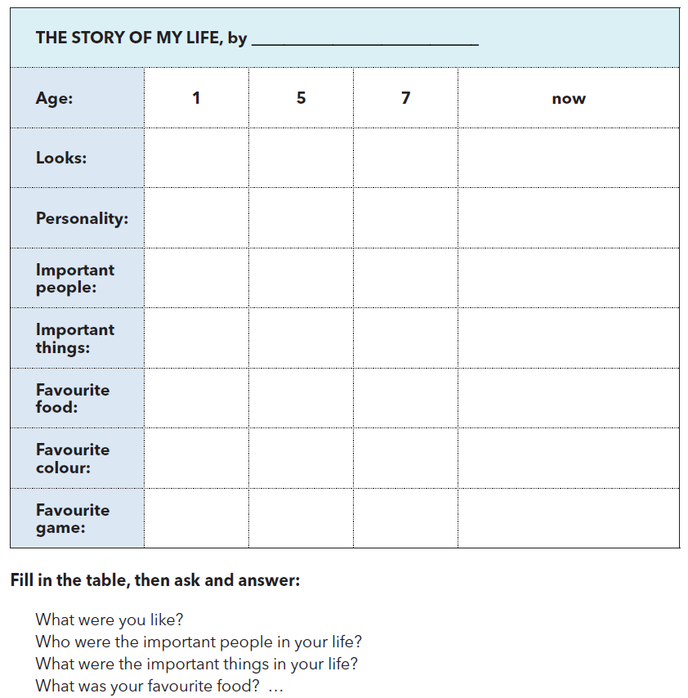
In small groups discuss your early childhood.
Fill in the chart and answer the questions below.

Slide 13
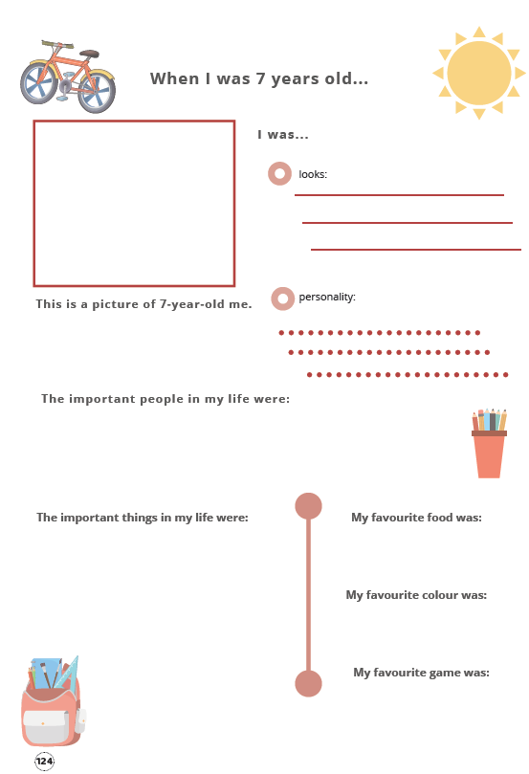
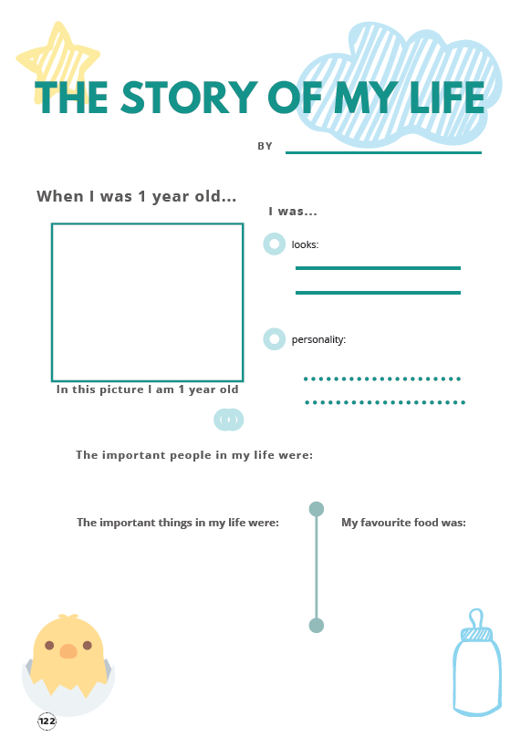
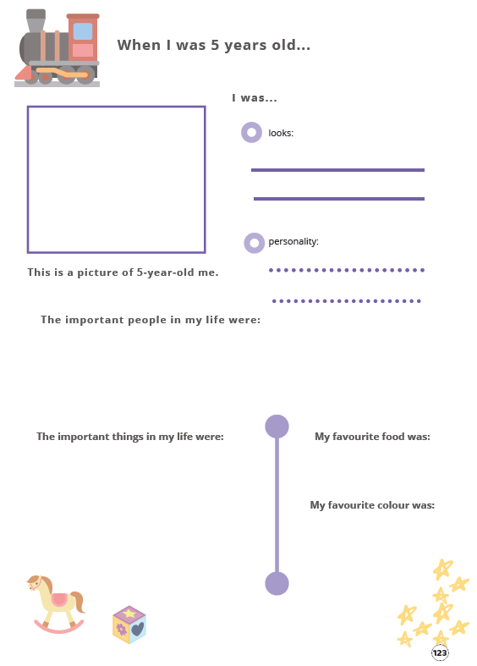
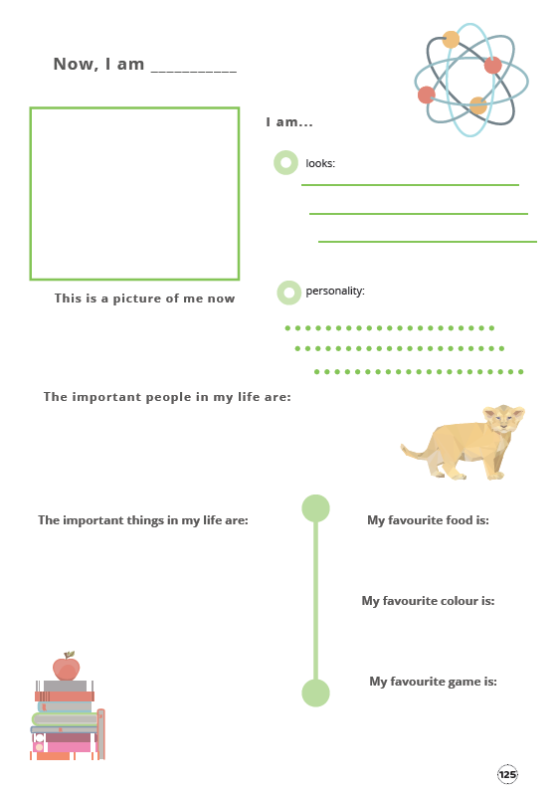
Pogledaj predloške i izradi slikovnicu o svome životu (kako si izgledao, kakav si bio tijekom godina, tko ti je bio važan u životu, što ti je bilo važno u životu, kakav si sada).
Slikovnica može biti papirnata ili digitalna.
Možeš koristiti prave fotografije ili sam sebe nacrtati.
U malim grupama predstavite radove jedni drugima. Po završetku jedan drugome recite što je bilo dobro, a što su mogli učiniti bolje.
U bilježnicu napiši što je bio najbolji dio, a što najlošiji dio ovog zadatka.

Slide 14

LET’S REVISE!
https://www.bookwidgets.com/play/t:G4eBCDjvmzQ4vKSsBnGU6ceRPFz0ojzynfbVdTY9pq5aRVBXVVQ=
https://learningapps.org/watch?v=pruc880pa18
SELF CHECK
https://www.e-sfera.hr/dodatni-digitalni-sadrzaji/8f9919bc-9e39-488c-86f9-4a6d3b4ba344/

Slide 15
LEARN MORE
https://www.e-sfera.hr/dodatni-digitalni-sadrzaji/8f9919bc-9e39-488c-86f9-4a6d3b4ba344/
Who smashed the window?

